Slide 1

Introduction to Machine Learning and Building a Recommendation Engine with Spark

Slide 2
What is Machine Learning?
● Machine learning is a method of data analysis that
automates analytical model building.
● Using algorithms that iteratively learn from data, machine
learning allows computers to find hidden insights without
being explicitly programmed where to look.

Slide 3
What is it used for?
● Fraud detection.
● Web search results.
● Real-time ads on web pages
● Credit scoring and next-best offers.
● Prediction of equipment failures.
● New pricing models.
● Network intrusion detection.
● Recommendation Engines
● Customer Segmentation
● Text Sentiment Analysis
● Predicting Customer Churn
● Pattern and image recognition.
● Email spam filtering.
● Financial Modeling

Slide 4
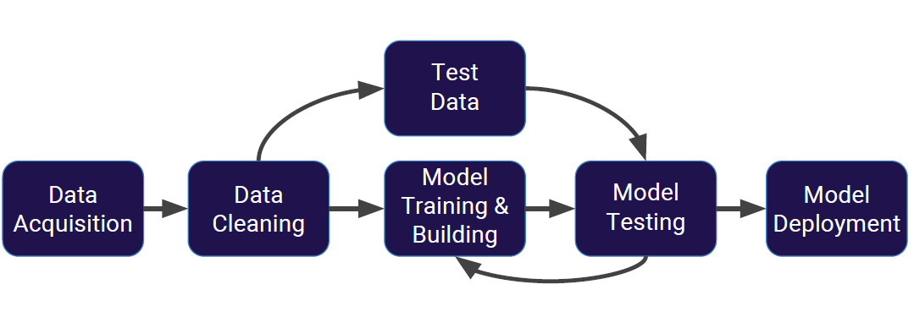
Machine Learning Process

Slide 5
Supervised Learning
● Supervised learning algorithms are trained using
labeled examples, such as an input where the desired
output is known.
● For example, a piece of equipment could have data points
labeled either “F” (failed) or “R” (runs).

Slide 6
Supervised Learning
The learning algorithm receives a set of inputs along with
the corresponding correct outputs, and the algorithm
learns by comparing its actual output with correct outputs
to find errors.
● It then modifies the model accordingly.
Through methods like classification, regression, prediction
and gradient boosting, supervised learning uses patterns
to predict the values of the label on additional unlabeled
data.
● Supervised learning is commonly used in applications
where historical data predicts likely future events.

Slide 7
Unsupervised Learning
Unsupervised learning is used against data that has no
historical labels.
● The system is not told the "right answer." The algorithm must
figure out what is being shown.
● The goal is to explore the data and find some structure
within.
Or it can find the main attributes that separate customer
segments from each other.
● Popular techniques include self-organizing maps,
nearest-neighbor mapping, k-means clustering and
singular value decomposition.
● These algorithms are also used to segment text topics,
recommend items and identify data outliers.

Slide 8
Reinforcement Learning
● Reinforcement learning is often used for robotics,
gaming and navigation.
● With reinforcement learning, the algorithm discovers
through trial and error which actions yield the greatest
rewards.
● This type of learning has three primary components: the
agent (the learner or decision maker), the environment
(everything the agent interacts with) and actions (what the
agent can do).
The objective is for the agent to choose actions that
maximize the expected reward over a given amount of
time.
● The agent will reach the goal much faster by following a
good policy.

Slide 9
Building a Recommendation Engine with Spark

Slide 10

Recommendation systems help narrow your choices to those that best meet your particular needs, and they are among the most popular applications of big data processing. This use case uses machine learning to perform parallel and iterative processing in Spark and covers:
Collaborative filtering for recommendations with Spark
Loading and exploring the sample data set with Spark
Using Spark MLlib's Alternating Least Squares algorithm to make movie recommendations
Testing the results of the recommendations

Slide 11
Tools required to run the projects
Spark
Scala
Sbt

Slide 12
Spark Intro
Spark enables to easily work with large scale data in terms of transformations on distributed data.
Spark is written in Scala
Programmer write programs in terms of transformations on distributed datasets
Spark might rerun or perform transformations multiple times for faster execution
Resilient Distributed Datasets(RDDs) : immutable, partitioned collection of objects spread across the cluster, store in RAM or on disk
Build through lazy parallel transformations
Automatically rebuilt on failure

Slide 13
Spark MLlib
MLlib is Spark’s scalable machine learning library consisting of common learning algorithms and utilities, including classification, regression, clustering, collaborative filtering, dimensionality reduction and optimization primitives.
We will use collaborative filtering in the today example for our movie recommender example.

Slide 14
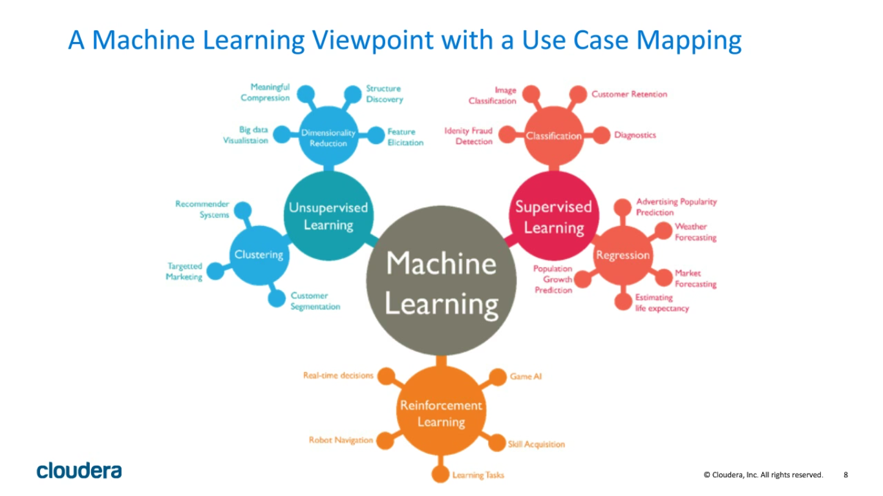

Slide 15
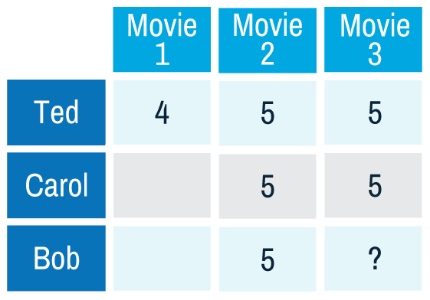
Collaborative Filtering
Collaborative filtering algorithms recommend items (this is the filtering part) based on preference information from many users (this is the collaborative part). The collaborative filtering approach is based on similarity; the basic idea is people who liked similar items in the past will like similar items in the future. In the example below, Ted likes movies A, B, and C. Carol likes movies B and C. Bob likes movie B. To recommend a movie to Bob, we calculate that users who liked B also liked C, so C is a possible recommendation for Bob. Of course, this is a tiny example. In real situations, we would have much more data to work with.

Slide 16
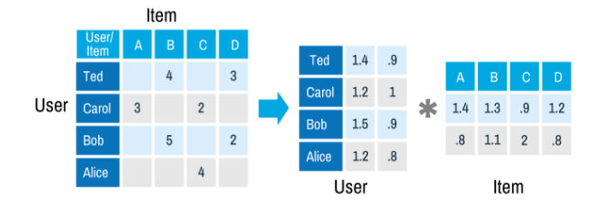
Collaborative Filtering
The factor matrices are also called latent feature models. The factor matrices represent hidden features which the algorithm tries to discover. One matrix tries to describe the latent or hidden features of each user, and one tries to describe latent properties of each movie.
ALS is an iterative algorithm. In each iteration, the algorithm alternatively fixes one factor matrix and solves for the other, and this process continues until it converges. This alternation between which matrix to optimize is where the "alternating" in the name comes from.

Slide 17
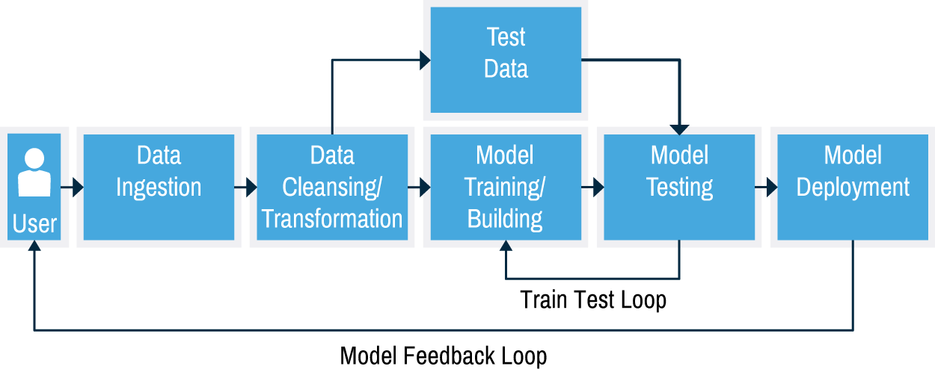
Typical Machine Learning Workflow
A typical machine learning workflow is shown below.

Slide 18
Movie recommender Mllib example
Input files :

Ratings.dat
Format : UserID::MovieID::Rating

Movies.dat
MovieID::Title::Genres

usersdat
UserID::Gender::Age::Occupation::Zip-code

Slide 19
For any Spark computation, we first create a SparkConf object and use it to create a SparkContext object. Since we will be using spark-submit to execute the programs in this tutorial (more on spark-submit in the next section), we only need to configure the executor memory allocation and give the program a name, e.g. “MovieLensALS”
val sqlContext = new org.apache.spark.sql.SQLContext(sc)

Slide 20
Splitting the training data
We will use MLlib’s ALS to train a MatrixFactorizationModel, which takes a RDD[Rating] object as input in Scala and RDD[(user, product, rating)] in Python.
○
ALS has training parameters such as rank for matrix factors and regularization constants.
To determine a good combination of the training parameters, we split the data into three non-overlapping subsets, named

training

test

validation, based on the last digit of the timestamp, and cache them.

Slide 21
Create Training Examples
import org.apache.spark.mllib.recommendation.{ALS, MatrixFactorizationModel, Rating}
// define the schemas using a case classes for Movie
// input format MovieID::Title::Genres
case class Movie(movieId: Int, title: String)
// define the schemas using a case classes for User
// input format UserID::Gender::Age::Occupation::Zip-code
case class User(userId: Int, gender: String, age: Int, occupation: Int, zip: String)

Slide 22
Cont...
// function to parse input into Movie class
def parseMovie(str: String): Movie = {
val fields = str.split("::") assert(fields.size == 3) Movie(fields(0).toInt, fields(1)) }
// function to parse input into User class
def parseUser(str: String): User = {
val fields = str.split("::") assert(fields.size == 5) User(fields(0).toInt, fields(1).toString, fields(2).toInt, fields(3).toInt, fields(4).toString)
}

Slide 23
Cont...
// function to parse input UserID::MovieID::Rating // and pass into constructor for org.apache.spark.mllib.recommendation.Rating class
def parseRating(str: String): Rating = {
val fields = str.split("::") Rating(fields(0).toInt, fields(1).toInt, fields(2).toDouble)
}
// load the data into an RDD
val ratingText = sc.textFile("/user/cloudera/datasets/ratings.dat")val ratingsRDD = ratingText.map(parseRating).cache()

Slide 24
Cont...
// load the data into DataFrames
val moviesDF= sc.textFile("/user/cloudera/datasets/movies.dat").map(parseMovie).toDF()
val usersDF = sc.textFile("/user/cloudera/datasets/users.dat").map(parseUser).toDF()
// create a DataFrame from ratingsRDD
val ratingsDF = ratingsRDD.toDF()

Slide 25
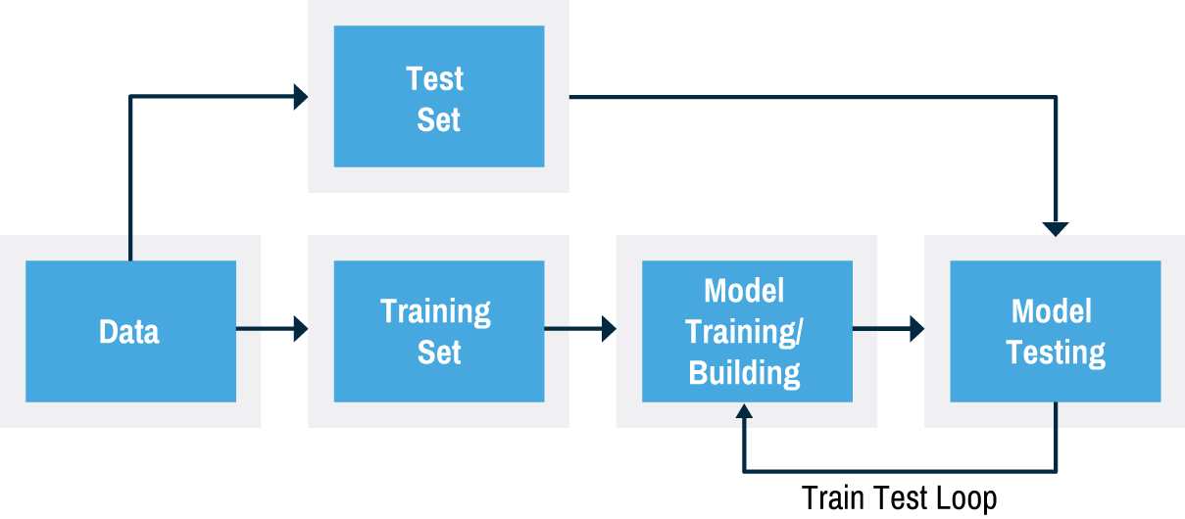
Using ALS with the Movie Ratings Data
Now we will use the MLlib ALS algorithm to learn the latent factors that can be used to predict missing entries in the user-item association matrix. First we separate the ratings data into training data (80%) and test data (20%). We will get recommendations for the training data, and then we will evaluate the predictions with the test data. This process of taking a subset of the data to build the model and then verifying the model with the remaining data is known as cross validation; the goal is to estimate how accurately a predictive model will perform in practice. To improve the model.

Slide 26
Using ALS with the Movie Ratings Data
We run ALS on the input trainingRDD of Rating(user, product, rating) objects with the rank and Iterations parameters:
rank is the number of latent factors in the model.
iterations is the number of iterations to run.
The ALS run(trainingRDD) method will build and return a MatrixFactorizationModel, which can be used to make product predictions for users.

Slide 27
Cont...
// Randomly split ratings RDD into training data RDD (80%) and test data RDD (20%)
val splits = ratingsRDD.randomSplit(Array(0.8, 0.2), 0L)
val trainingRatingsRDD = splits(0).cache()
val testRatingsRDD = splits(1).cache()
// Build the recommendation model using ALS with rank=20, iterations=10val model = ALS.train(trainingRatingsRDD, 20, 10)
Or
val model = (new ALS().setRank(20).setIterations(10).run(trainingRatingsRDD))

Slide 28
Making Predictions
Now we can use the MatrixFactorizationModel to make predictions. First, we will get movie predictions for the most active user, 4169, with the recommendProducts() method, which takes as input the userid and the number of products to recommend. Then we print out the recommended movie titles.
// Make movie predictions for user 4169
val topRecsForUser = model.recommendProducts(4169, 10)
// print out top recommendations for user 4169 with titles
topRecsForUser.map(rating => (movieTitles(rating.product), rating.rating)).foreach(println)

Slide 29
Evaluating the Model
Next, we will compare predictions from the model with actual ratings in the testRatingsRDD. First we get the user product pairs from the testRatingsRDD to pass to the MatrixFactorizationModel predict(user: Int, product: Int) method, which will return predictions as Rating(user, product, rating) objects.
// get predicted ratings to compare to test ratings
val predictionsForTestRDD = model.predict(testRatingsRDD.map{case Rating(user, product, rating) => (user, product)})
predictionsForTestRDD.take(10).mkString("\n")
// prepare the predictions for comparison
val predictionsKeyedByUserProductRDD = predictionsForTestRDD.map{ case Rating(user, product, rating) => ((user, product), rating)}

Slide 30
Cont...
// prepare the test for comparison
val testKeyedByUserProductRDD = testRatingsRDD.map{ case Rating(user, product, rating) => ((user, product), rating) }
//Join the test with the predictions
val testAndPredictionsJoinedRDD = testKeyedByUserProductRDD.join(predictionsKeyedByUserProductRDD)testAndPredictionsJoinedRDD.take(10).mkString("\n")

Slide 31
Summary
Spark MLlib is a module (a library / an extension) of Apache Spark to provide distributed machine learning algorithms on top of Spark’s RDD abstraction. Its goal is to simplify the development and usage of large scale machine learning.
You can teach a system from a dataset and let the system act by itself to predict future.
The amount of data (measured in TB or PB) is what makes Spark MLlib especially important since a human could not possibly extract much value from the dataset in a short time.

Slide 32
Machine Learning Handson
https://drive.google.com/drive/u/0/folders/1Mvnug3ZRdGty2f_El20AmlzvkfigNJfM

